Slide 1
dVRK Hamlyn 2016 User meetup
Anton Deguet, Peter Kazanzides
Johns Hopkins University
June 25, 2016

Slide 2
Outline
Group introduction
Brief history
Updates
Hardware
Ethernet
SUJs
Software
Main features in upcoming 1.4
Python and Matlab ROS wrappers
Future developments

Slide 3
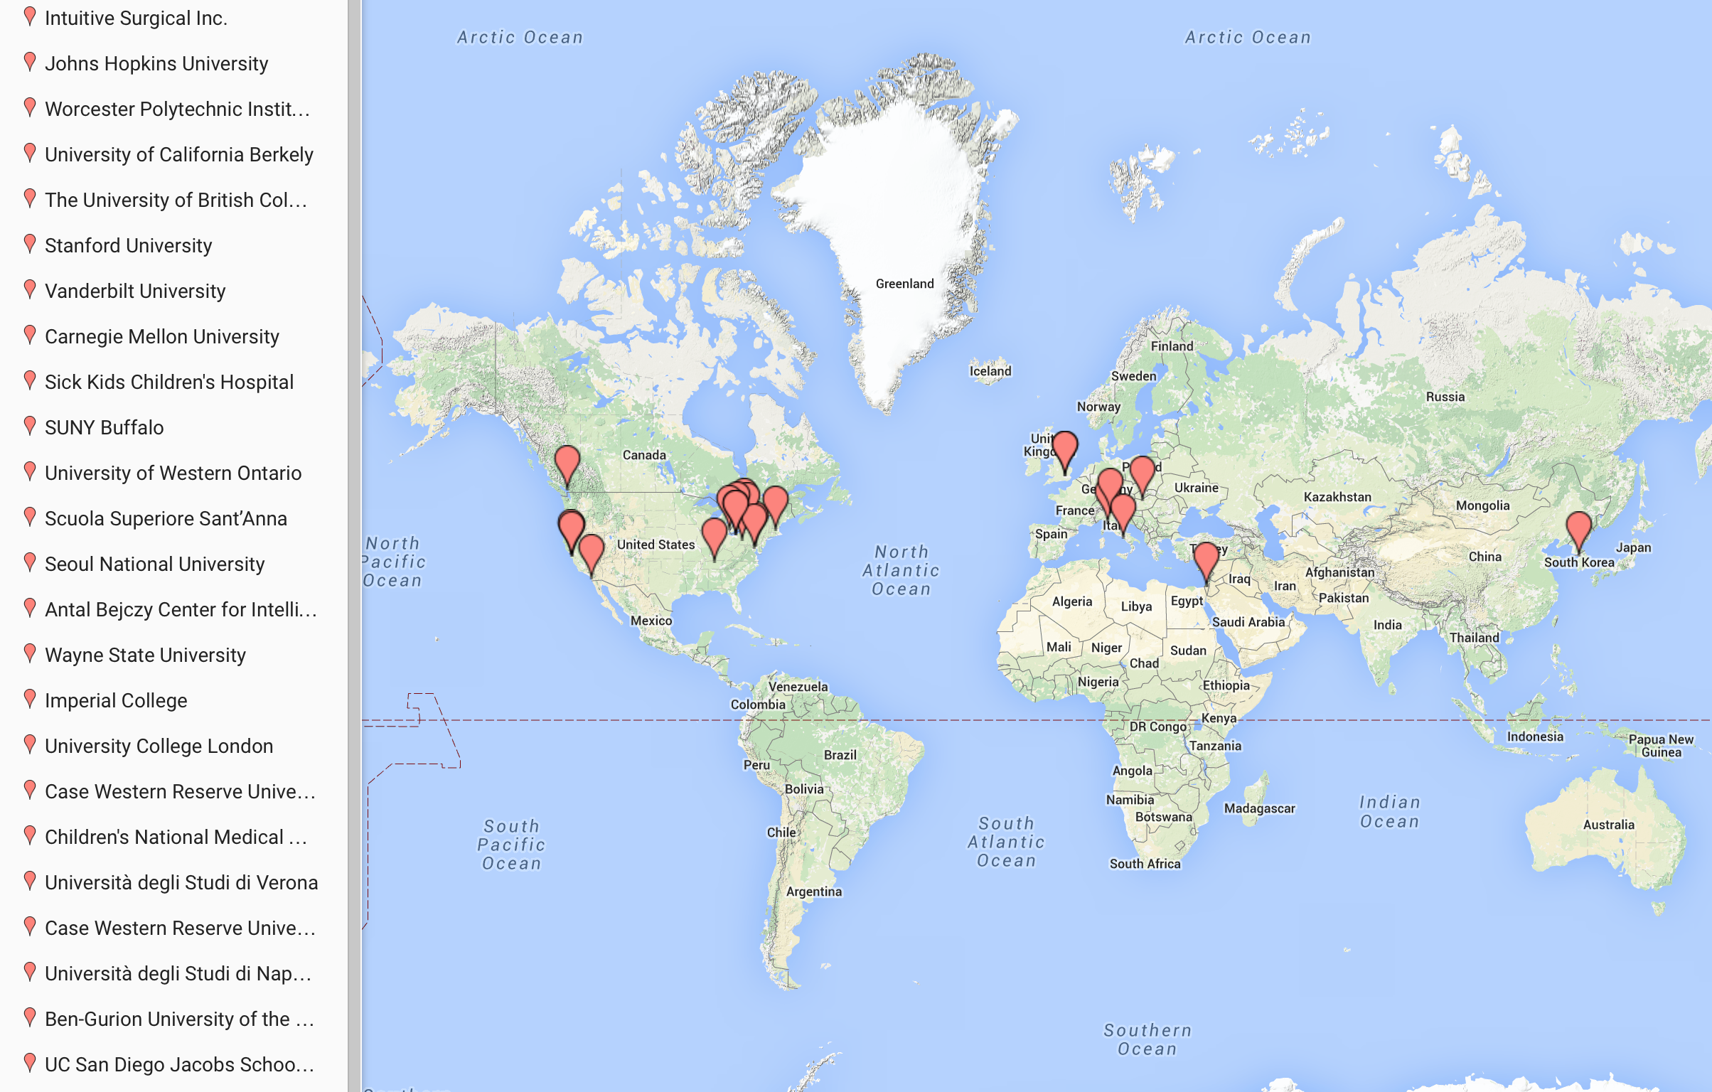
dVRK Sites
Hong Kong
Milan
26 groups

Slide 4
Group introduction
Who you are
Which system are you using:
Research Kit: 2 MTMs, 2 PSMs
daVinci: whole system with ECM and SUJs
Research interests
New tools
Vision, tool tracking, imaging, US, …
Force feedback, user UI, augmented reality, …
Automated motion, virtual fixtures, …
What have you done so far:
Waiting for controller or it boots!
We just run the provided applications
We hacked the C++ code
It’s just another ROS node

Slide 5
Overall goals
Stability
Algorithms (PID, kinematics, filters)
Efficient (memory and CPU usage)
Safe (error checking, redundancy)
Bug free?
Sustainability
Leverage on existing components (ROS, RViz, Reflexxes, JsonCpp, Qt, …)
Code re-factorization (base classes)
Stable and consistent APIs (naming, data types)
Usability
Interfaces (GUI, ROS, OpenIGTLink)
Flexibility (configuration files vs compiled code)
Extensibility (derived classes)

Slide 6
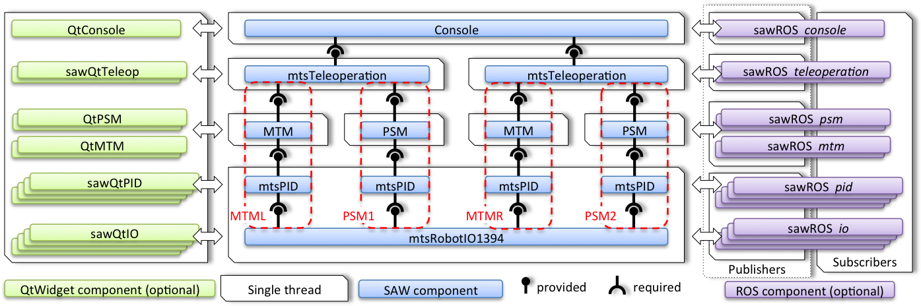
History, 01/15 rev 1.0
Rough draft, alpha, it moves!
Somewhat stable, sustainable and usable…

Slide 7
History, 04/15 rev 1.1
Initial feedback
Each system is different, need more flexible parameterization
Each user does something different, testing cases we didn’t
Urgent fixes
Added safety checks
Using potentiometers for safety checks
Preload encoders, check encoder overflow
Error propagation across components
More and better messages to GUI and logs
Improvements
Refactoring code (arm base class)
Ongoing API cleanup
LSPB trajectory generation
FireWire broadcast
More ROS topics (for data collection), catkin build
Bug fixes

Slide 8
History, 10/15 rev 1.2
Console configuration file
Avoids many recompilations
Simple JSON syntax https://github.com/jhu-dvrk/sawIntuitiveResearchKit/wiki/FileFormats
Populates components based on configuration
Core: IO, PID, Arm, ..
Qt Widgets
ROS bridges
Improved velocity estimation, better PID gains
Support for upcoming SUJ controller

Slide 9
History, rev 1.2
More on velocity estimation
Users reported unstable control, jumps in requested current
Initially thought that unstable IO/PID periodicity was the problem
Velocity estimate was bad because of low encoder resolution. Usual fixes are:
Increase refresh rate, in dx/dt this leads to higher peaks in velocities
Increase damping in PID, also increases peaks in commanded torques
Now uses mix of:
dx/dt where dx is position change since last read if dx > 1 and dt is time since last read (fast motion)
1/dt where dt is time since last position change (slow motion)

Slide 10
History, 01/16 rev 1.3
Tool configuration file
DH, coupling, joint limits in a single file
Coupling can be changed dynamically so trajectories can be used during homing/engage procedure, side effect is better PSM PIDs
Better homing
Potentiometer calibration
PSM doesn’t move if tool is present
MTM roll limit search performed only once
Improved some safety checks to avoid false alarms
Added kinematic simulation (live demo?)
Added SetWrench methods with ROS topics

Slide 11
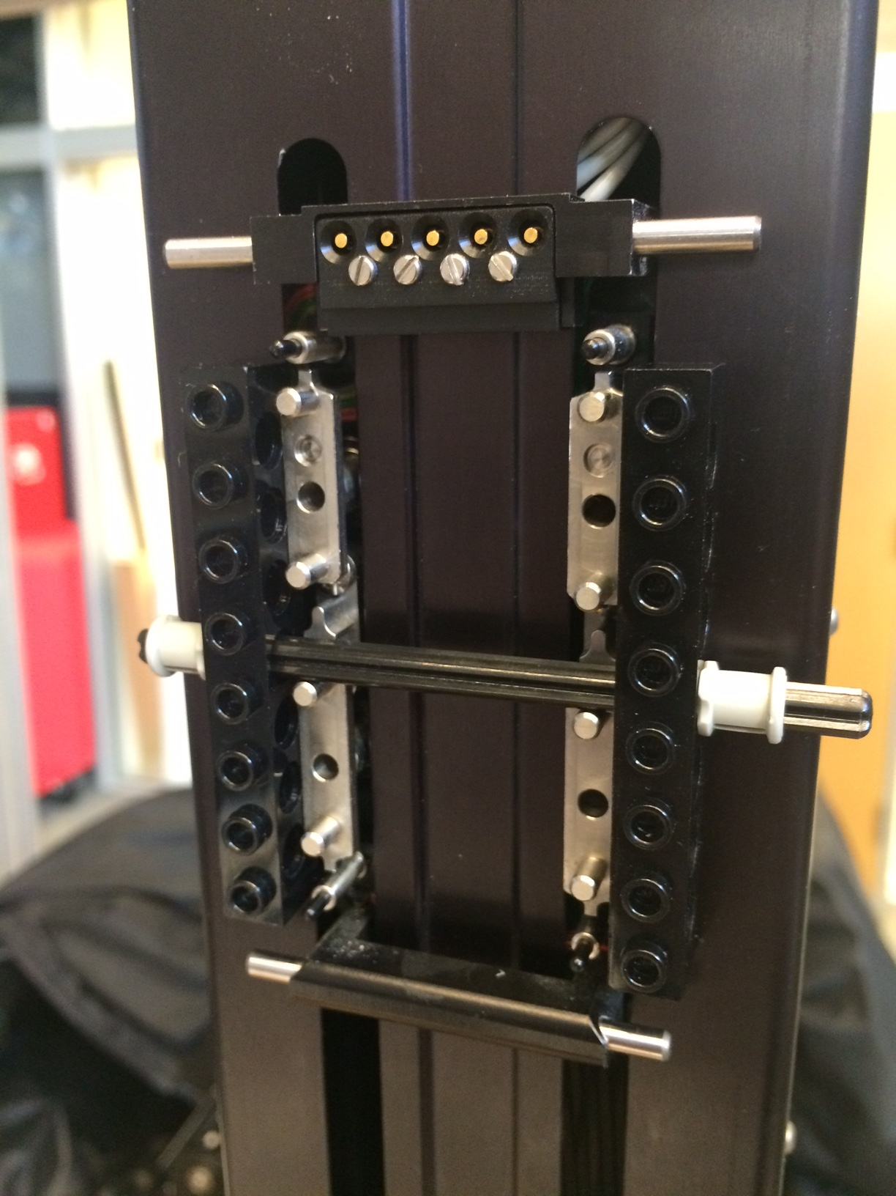
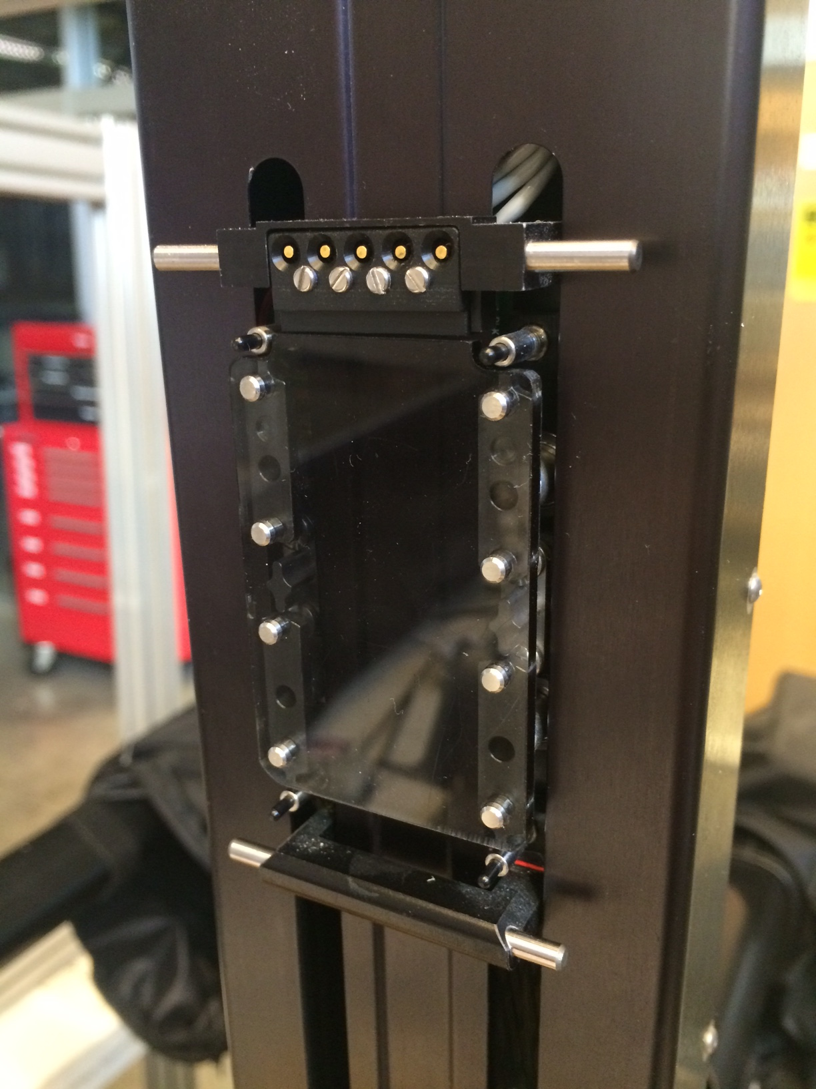
History, rev 1.3
More on potentiometers
Readings are noisy and delayed
Filtering (avg) when a precise value is needed, e.g. homing
Redundancy check now takes time into account (fails if multiple consecutive values are off)
Calibration was off
Calibrate scales using encoders (~2%) Important for large motions ☺
Calibrate offsets using physical features
Easy on PSM joints 4-7 (<2 degrees) Not large effect on accuracy ☹
No solution yet for all others joints

Slide 12
Hardware update: Ethernet

Slide 13
Hardware update: SUJ
New dSIB (daVinci Setup Interface Board)
Single FPGA/QLA board for all 4 SUJs
Motor power used to release breaks
Analog inputs used to read potentiometers
Digital outputs used to:
Control multiplexer for potentiometers, SUJs have 6 joints x 2 redundant pots x 4 arms potentiometers, QLA have 4 analog inputs
Control PWM drive on dSIB for PSM 3 lift
Status
Testing dSIB rev 3.0
Have to design enclosure, mounted on patient side cart

Slide 14
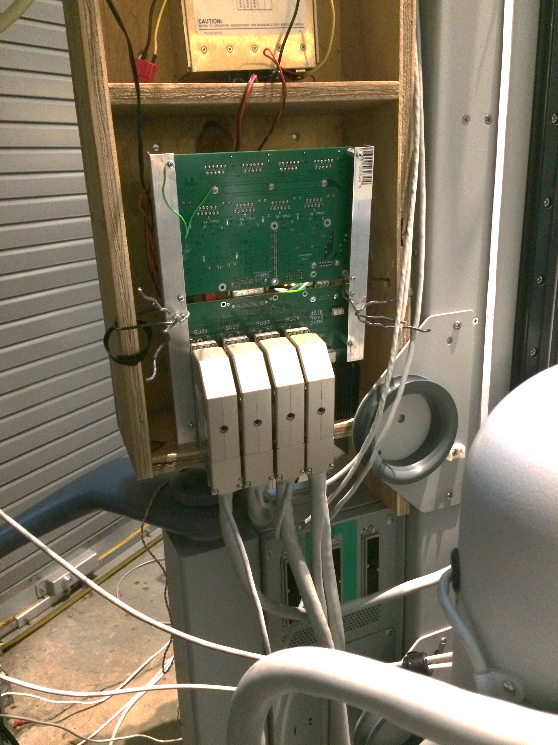
Hardware update: SUJ
Cart
QLA
dSIB

Slide 15
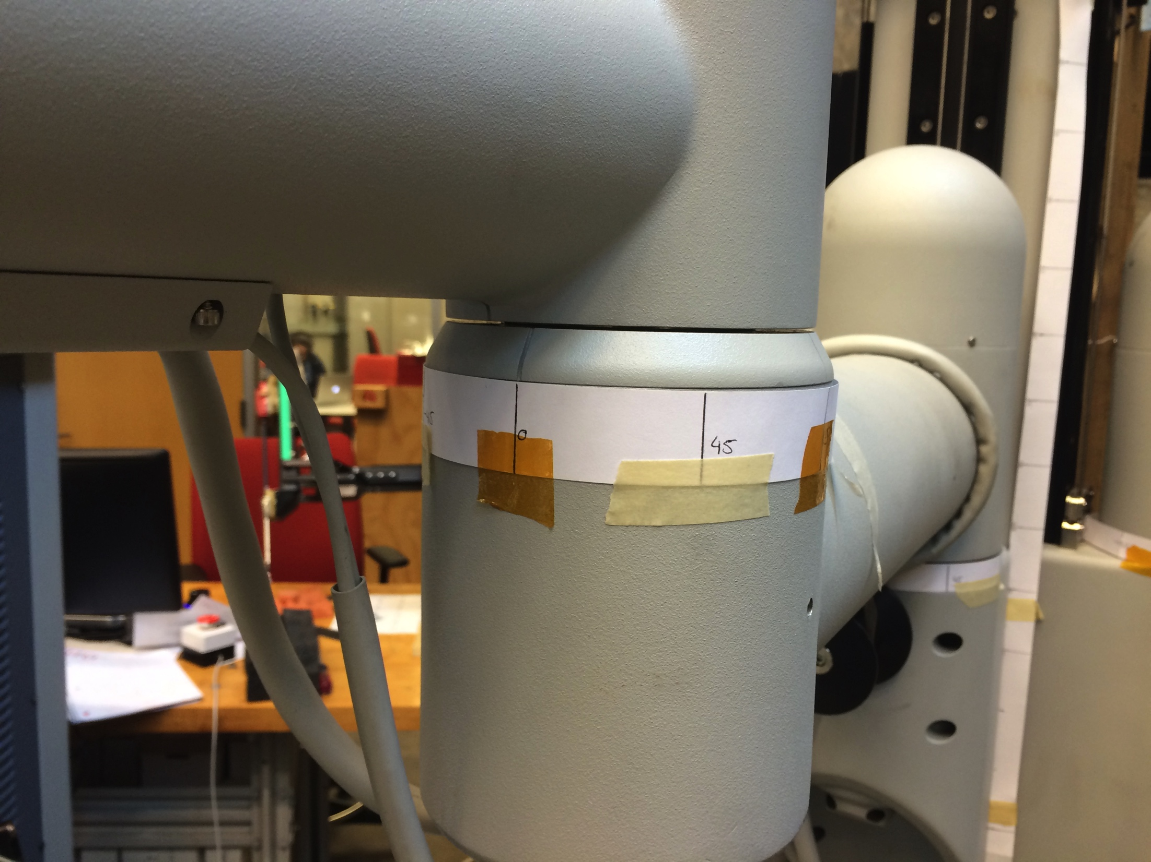
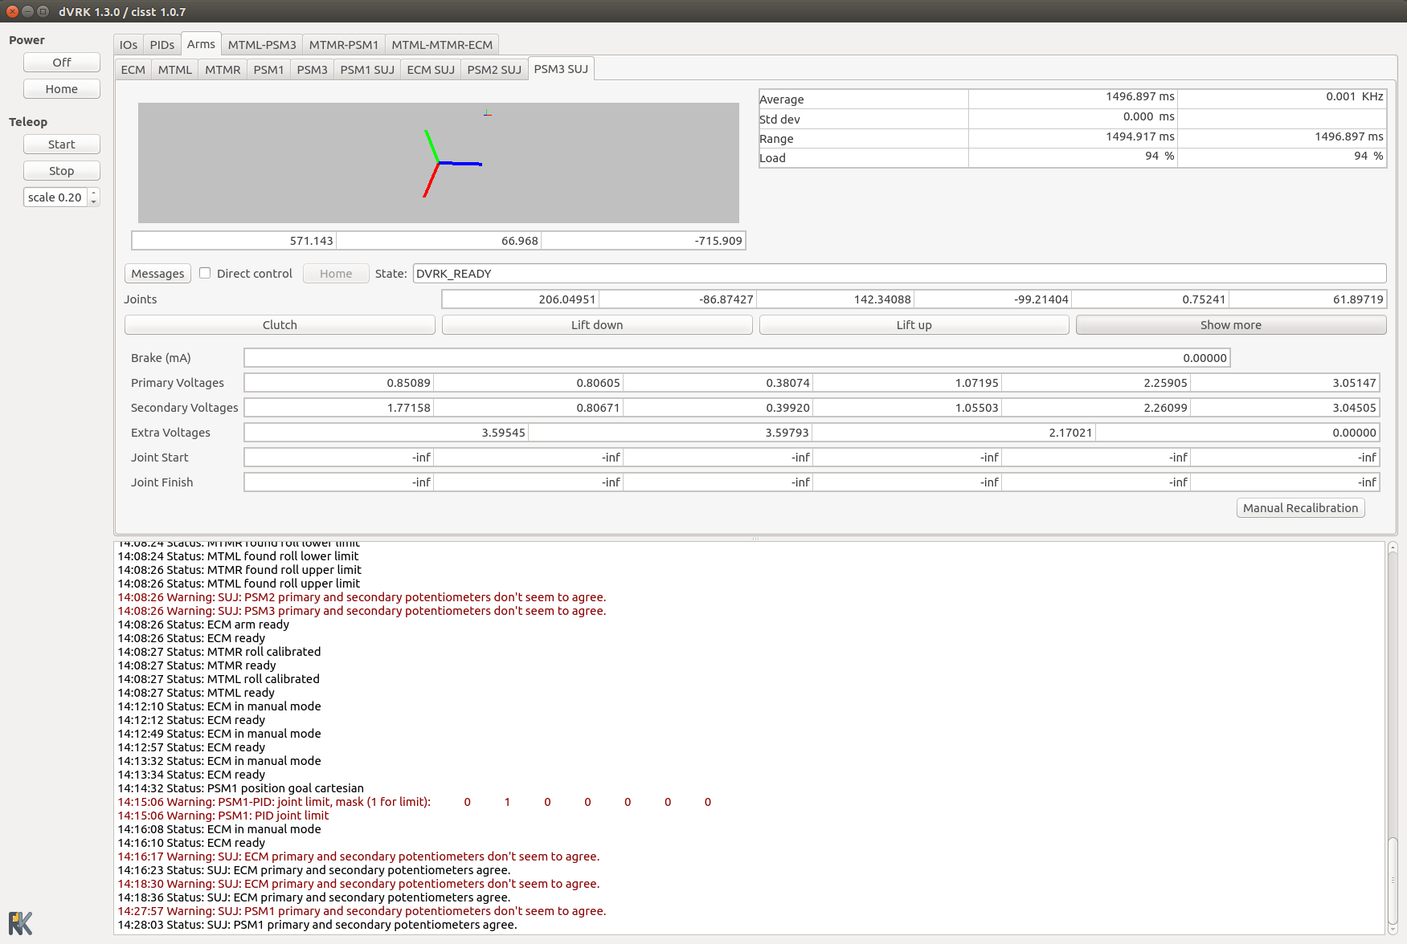
Hardware update: SUJ
Potentiometer calibration
Add labels on joints (we will provide pdf)
Move to known positions, joint by joint and enter in GUI
Code computes slopes and offsets
Copy/paste output in configuration file (JSON)

Slide 16
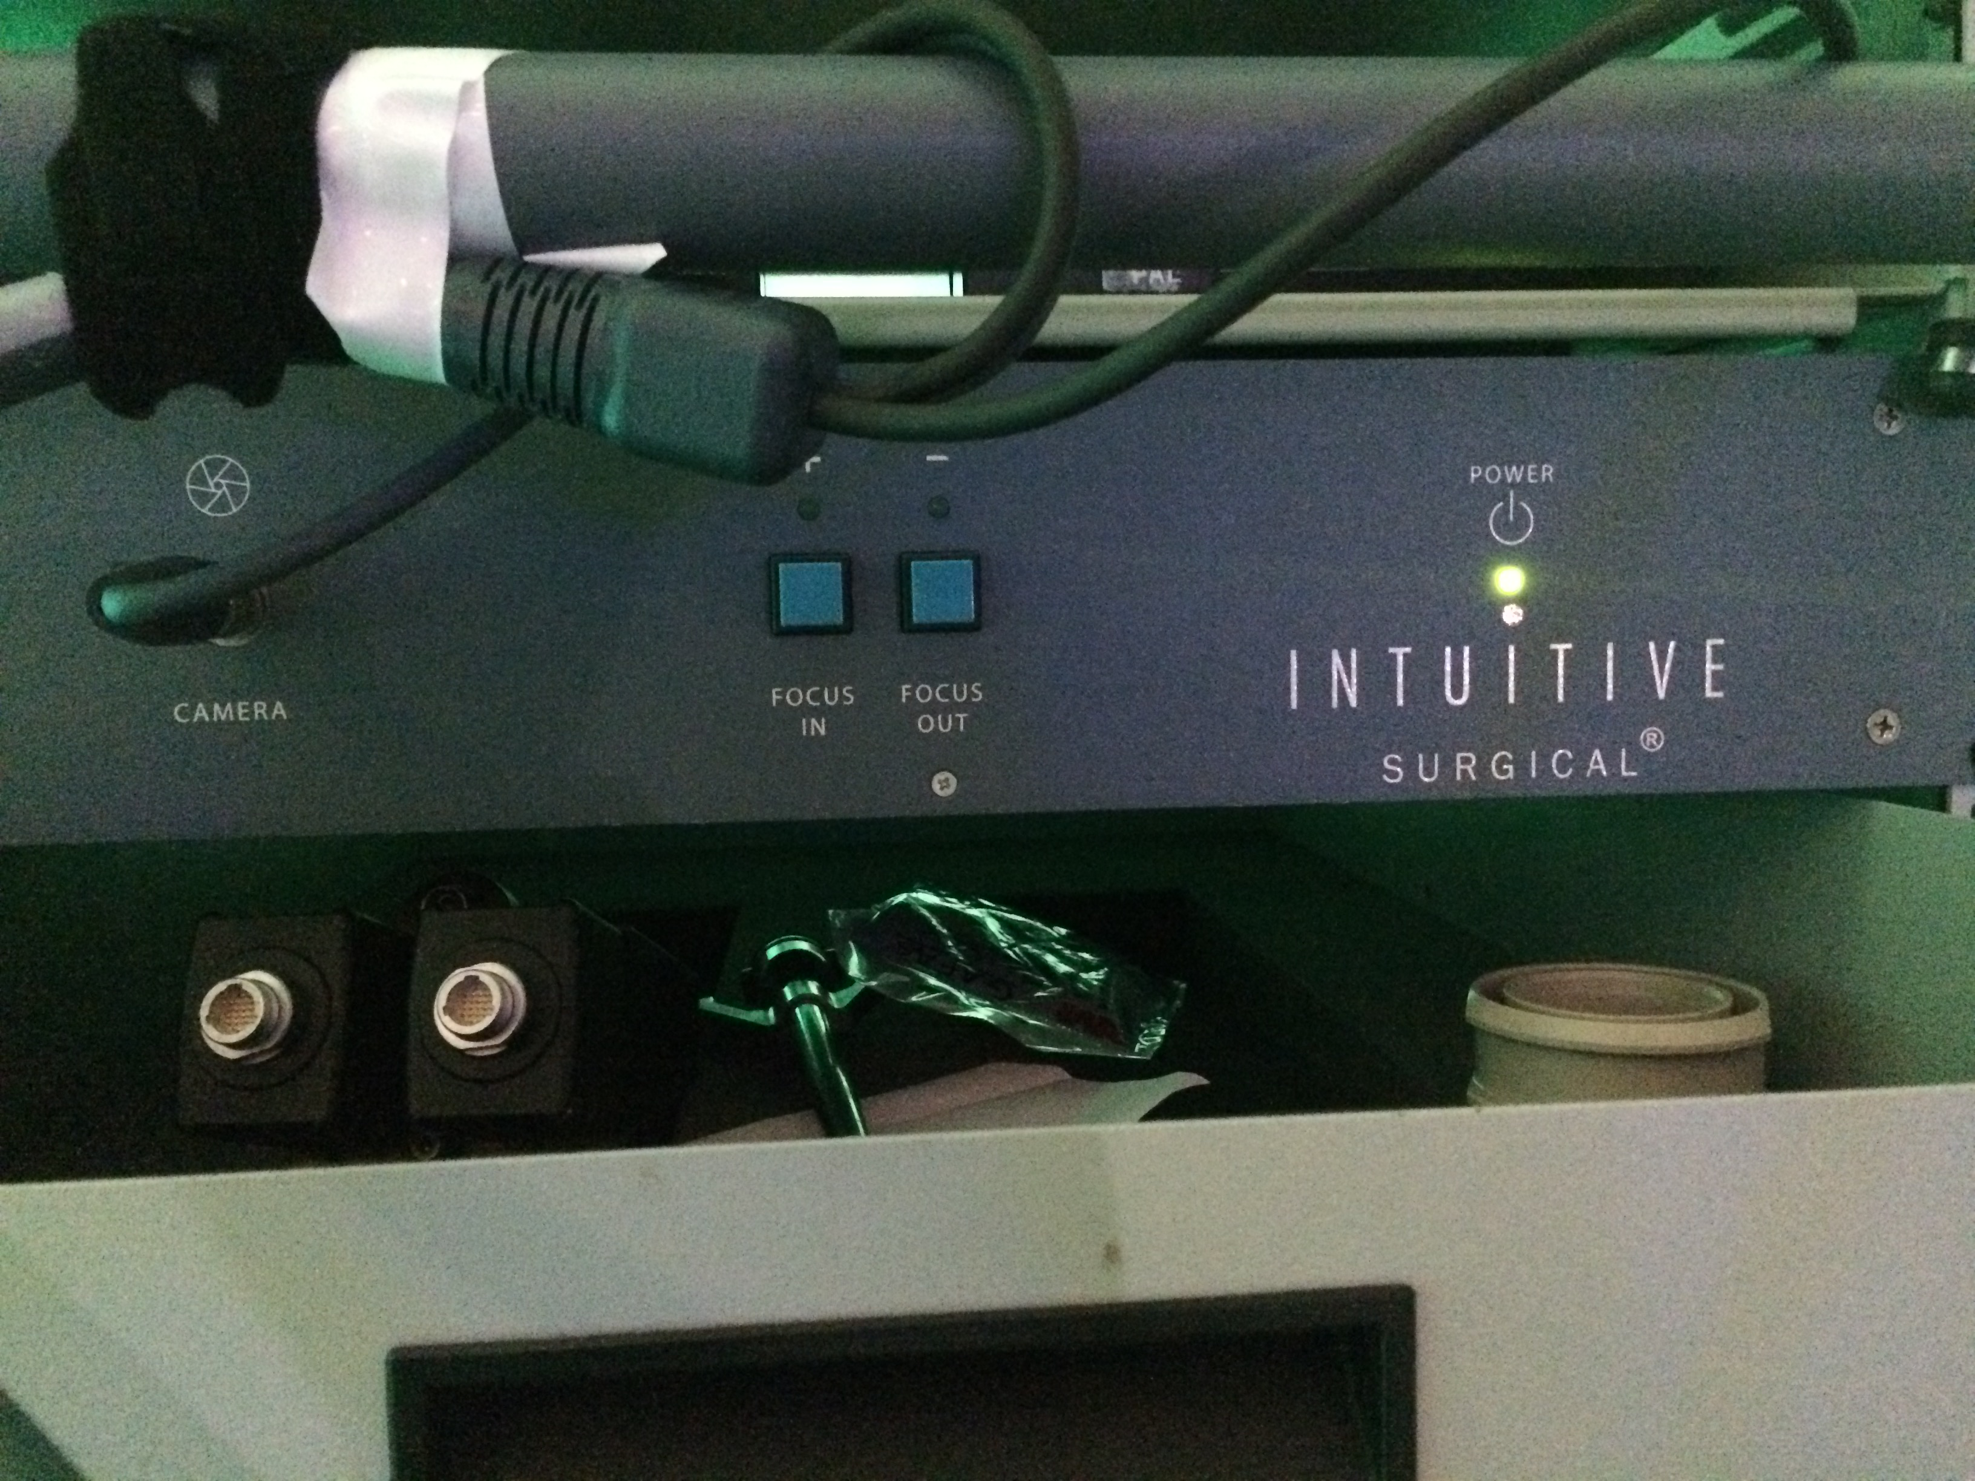
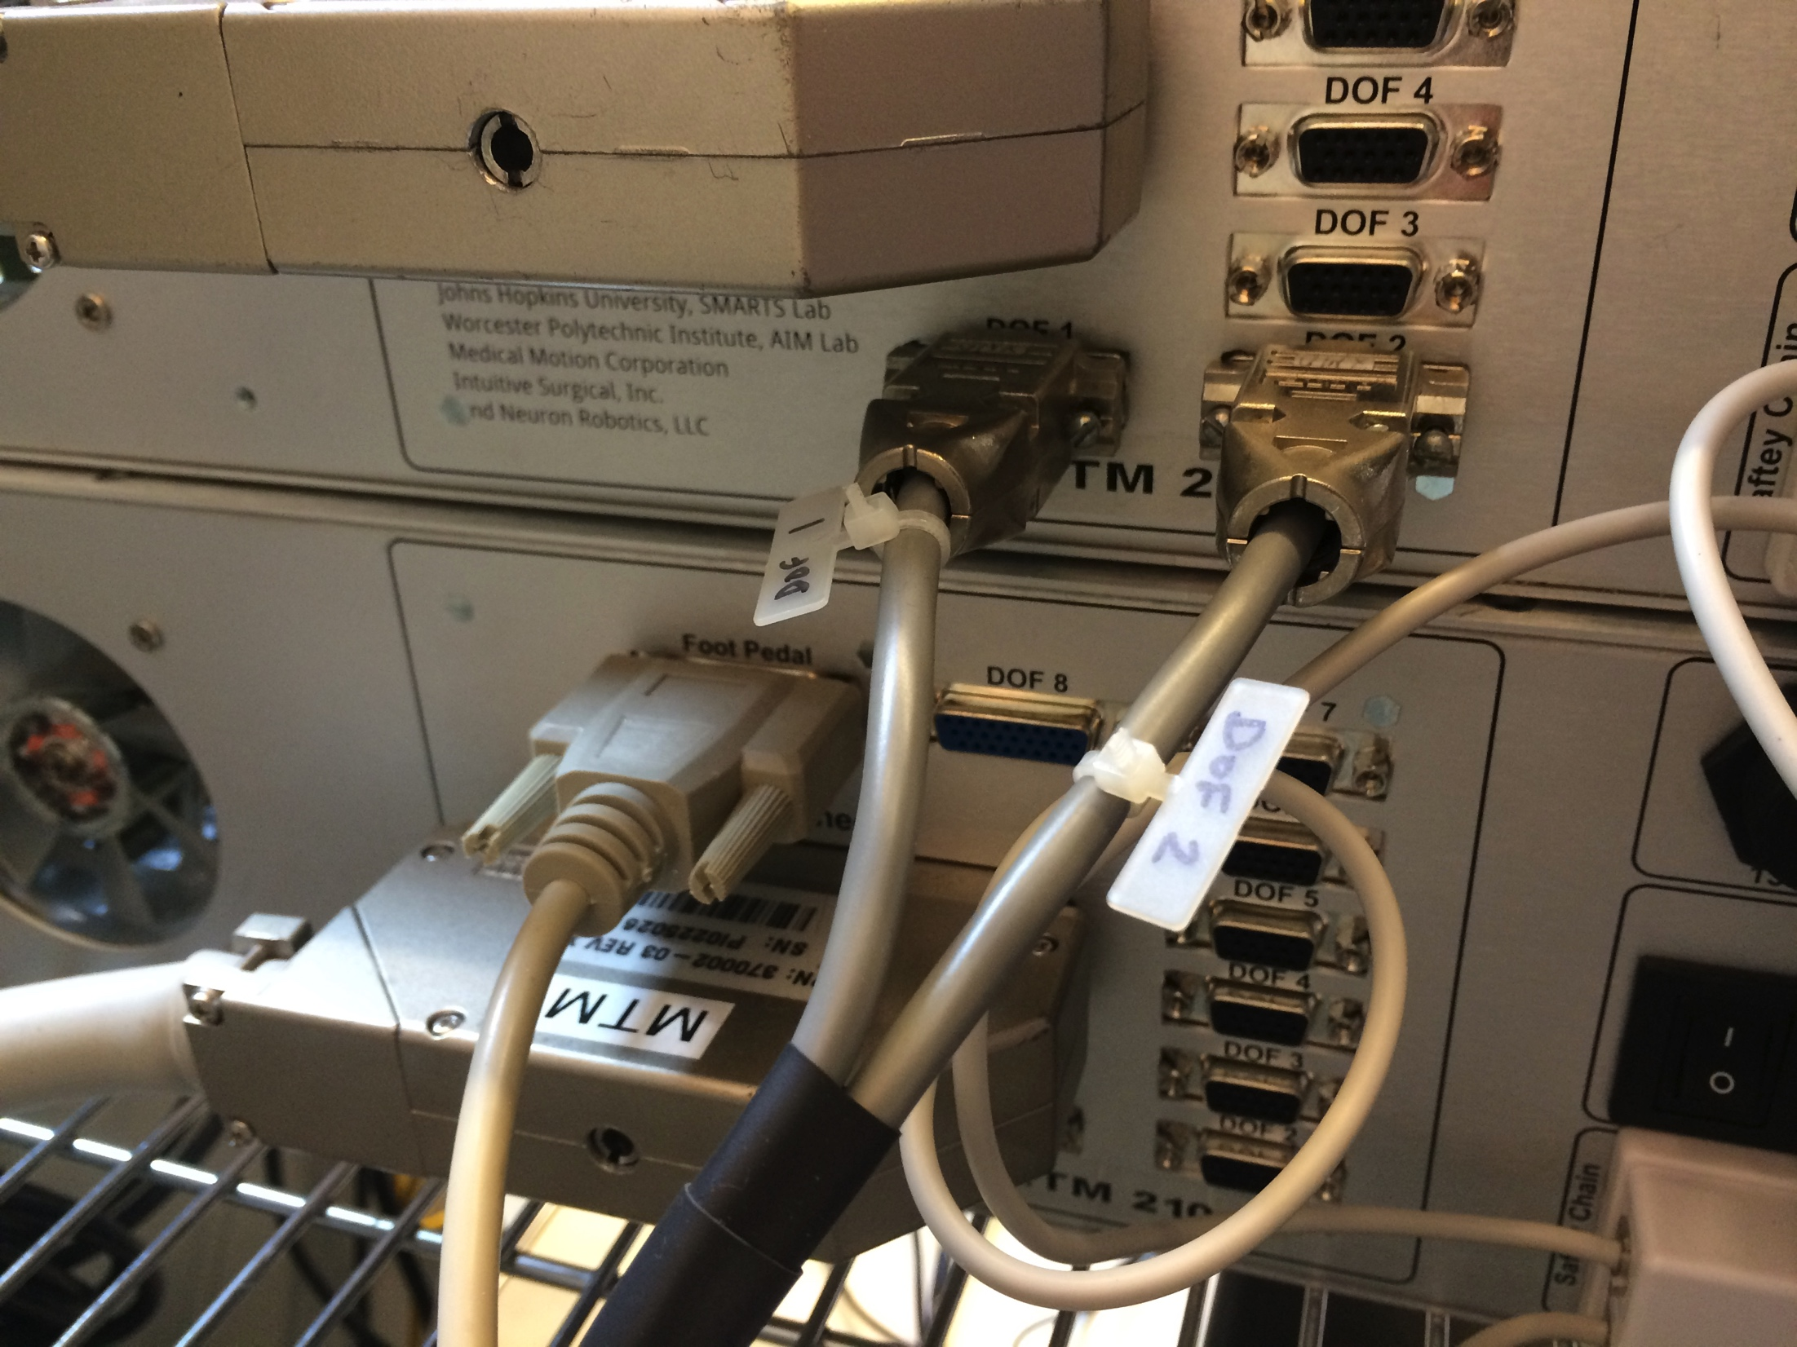
Hardware update: Endoscope Focus
Control endoscope focus using dVRK digital outputs
Custom cable (done)
Software (to do)
https://github.com/jhu-dvrk/sawIntuitiveResearchKit/wiki/Full-da-Vinci
https://github.com/jhu-dvrk/sawIntuitiveResearchKit/wiki/Full-da-Vinci

Slide 17
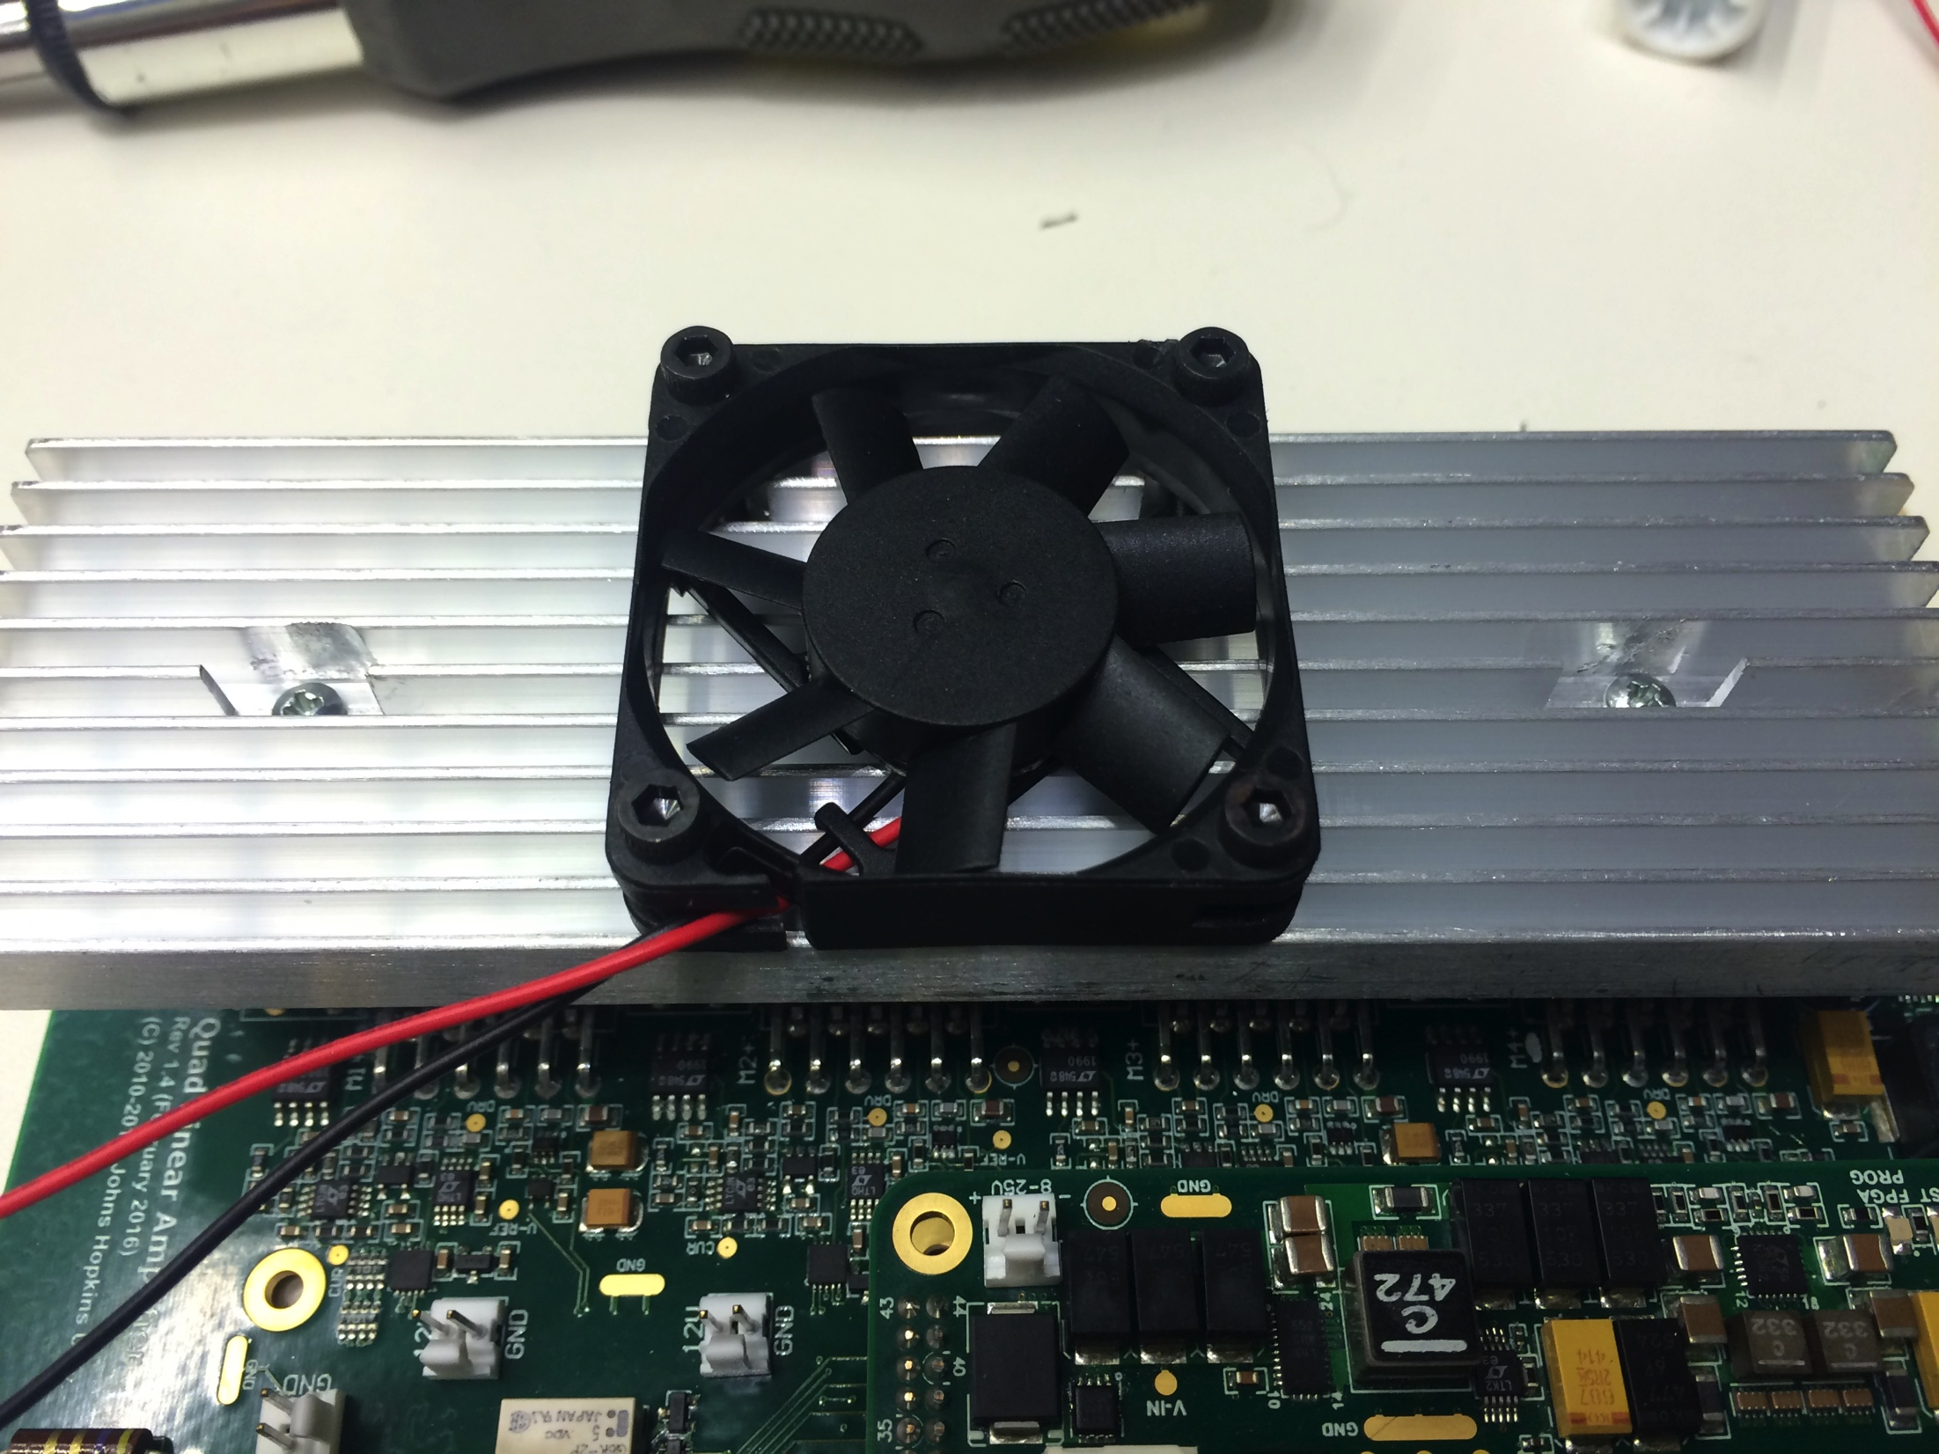
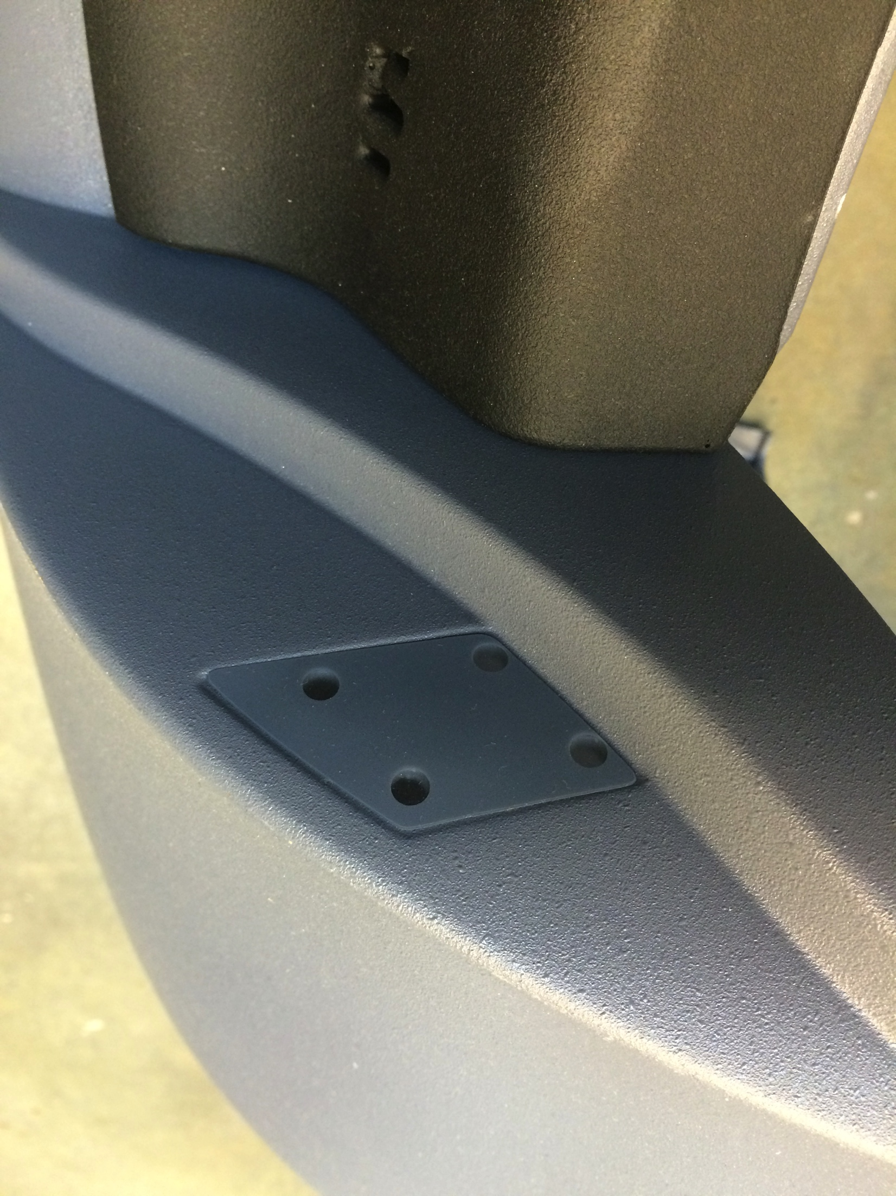
Hardware updates
Heat sink for ECM/SUJ
Head sensor?

Slide 18
Upcoming 1.4
More logic implemented in the console component
Better management of transitions between components, e.g. teleop PSM / ECM
Less code in each teleop component
Control all components from a single point (Qt Widget, ROS topics, …)
Home, power off arms
Start stop teleoperations, set scale
Console Qt widget stays visible

Slide 20
Upcoming 1.4
Teleop PSM
Less events managed by component, tool clutch and operator present are handled by the console
Use new “state machine” class for a cleaner implementation, can be easily derived
Added states and transitions:
Is PSM ready?
Is MTM ready?
Is MTM aligned?
Better MTM orientation lock in clutch mode

Slide 21
Upcoming 1.4
Teleop ECM
Similar to PSM, check state of arms
Added force feedback on MTMs
Fixed distance between MTMs
Equal distance to eye piece
Viscosity
Still working on ECM motion…
Might require a new trajectory generator
Last feature required before release

Slide 22
Upcoming 1.4
Better ROS interfaces
Use messages with header when possible
For example, PoseStamped instead of Pose
Timestamps using initial cisst/SAW value
Name in message
Sequence number (e.g. event counting)
Added compatibility mode in dVRK ROS applications
dvrk_console_json –c v1_3_0
dvrk_console_json
Fix for new catkin build tool (v0.4+, also Ubuntu 16.04 with ROS Kinetic)
More topics for arms (wrench, twist), console (home, start/stop teleop, scale), teleop components…

Slide 23
Upcoming 1.4
Better ROS wrappers
Python
Fixed import command, uses standard ROS paths
arm, psm, mtm, ecm, suj and console classes
Cleanup interface
Shorter names (move, dmove)
Use better types (PyKDL and Numpy arrays)
Should be stable from now on
Matlab
Require Matlab robotic system toolbox (> 2015a, not free)
Runs everywhere (Linux, Windows, MacOS)
API consistent with Python API, except types are all arrays

Slide 24
Upcoming 1.4
r = arm('PSM1);
r.position_desired % [4x4 double]
r.position_joint_desired % [7x1 double]
r.effort_joint_desired % [7x1 double
r.position_current % [4x4 double]
r.position_joint_current % [7x1 double]
r.velocity_joint_current % [7x1 double]
r.effort_joint_current % [7x1 double
r.home(); % home this arm
% move joint 1 only, index start at 1, radians
r.dmove_joint_one(-0.01, int8(3));
% move all joints, radians and meters
r.dmove_joint([-0.01, -0.01, 0.0, 0.0, 0.0, 0.0, 0.0]);
% move in cartesian space, translation only.
v = [0.0, 0.0, 0.01];
r.dmove_translation(v)
Similar commands without the [d]move prefix exist (start with move) and allow you to use absolute positions

Slide 25
Upcoming 1.4
import dvrk
# Create a Python proxy for PSM1, name must match ros namespace
p = dvrk.psm('PSM1')
# You can home from Python
p.home()
# retrieve current info (numpy.array)
p.get_current_joint_position()
p.get_current_joint_velocity()
p.get_current_joint_effort()
# retrieve PID desired position and effort computed
p.get_desired_joint_position()
p.get_desired_joint_effort()

Slide 26
Upcoming 1.4
# retrieve cartesian current and desired positions
# PyKDL.Frame
p.get_desired_position()
p.get_current_position()
# move in joint space
# move is absolute (SI units)
# dmove is relative
# move a single joint, index starts at 0
p.dmove_joint_one(-0.05, 2) # move 3rd joint
p.move_joint_one(0.2, 0) # first joint
# move all joints
p.dmove_joint(numpy.array([0.0, 0.0, -0.05, 0.0, 0.0, 0.0, 0.0]))
p.move_joint(numpy.array([0.0, 0.0, 0.10, 0.0, 0.0, 0.0, 0.0]))

Slide 27
Upcoming 1.4+
These might make it to 1.4
Ethernet support
Use Reflexes/RML for trajectory generation
Might be required for teleop ECM
Would be nice for all commands
Could add cartesian trajectories as well
Add ROS TF support, specially for SUJ
Better handling of redundant joints in MTMs
We have some preliminary work with joint motion minimization and joint limits
Issue when in gravity mode
Use new state machine in arm classes
Current implementation is hard to maintain
Challenging to derive from MTM, PSM, …

